Slide 1
Data Manipulation

Slide 2
File Formats

Slide 3

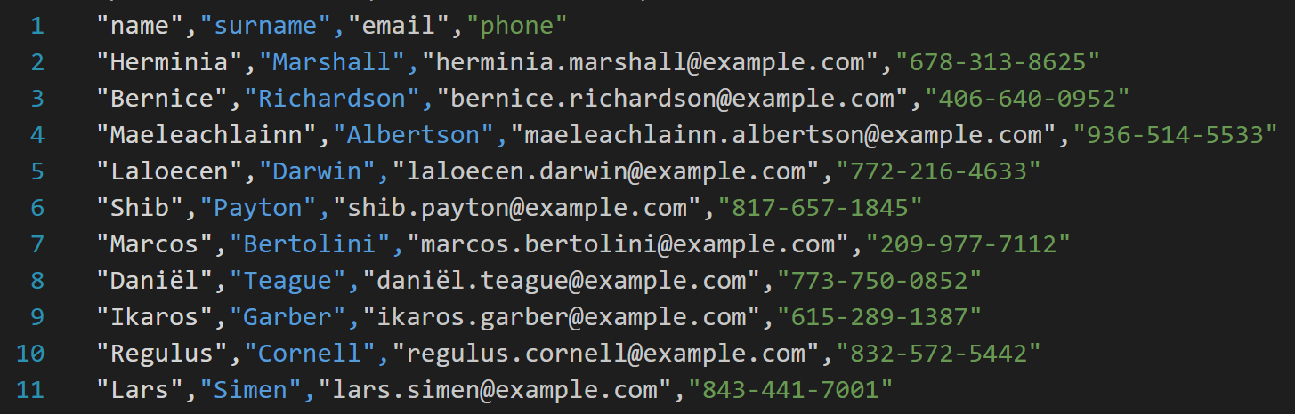
.csv

Slide 4

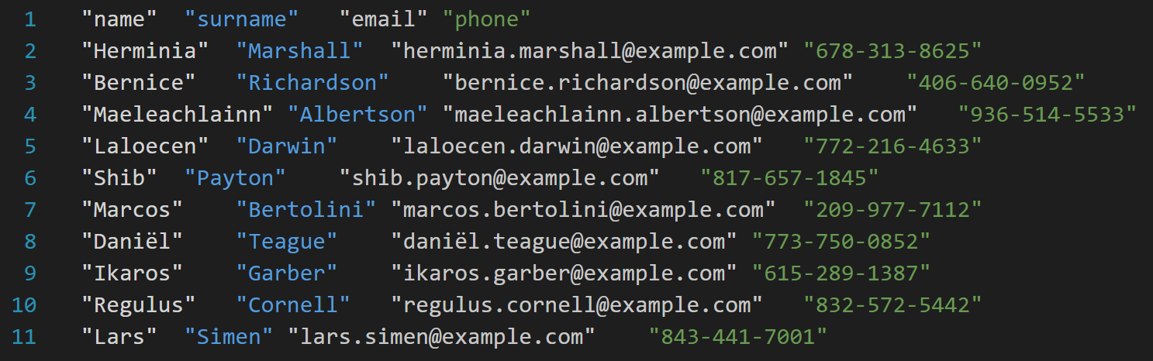
.tsv

Slide 5
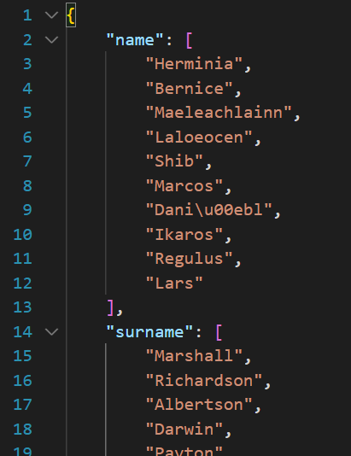

.json

Slide 6
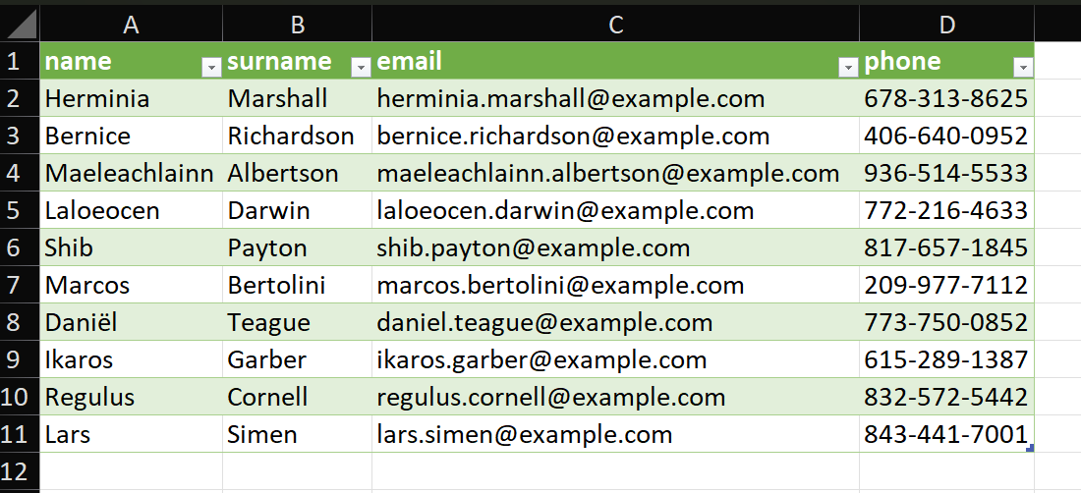

.xlsx

Slide 7

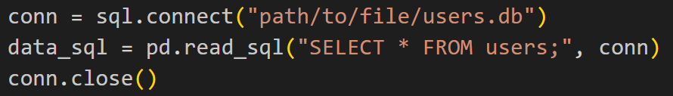
SQL

Slide 8
How to assess data quality

Slide 9
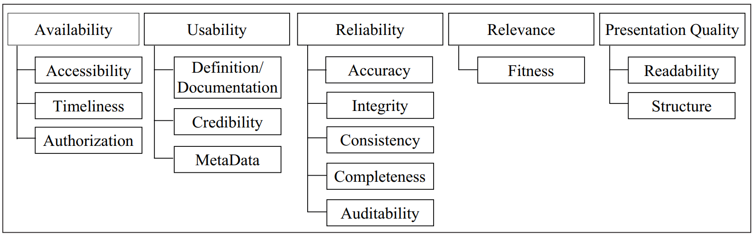
How to assess data quality

Slide 10
Availability

Slide 11
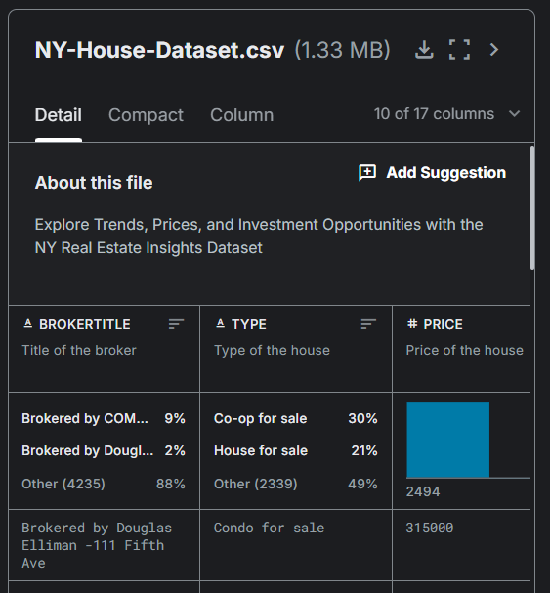
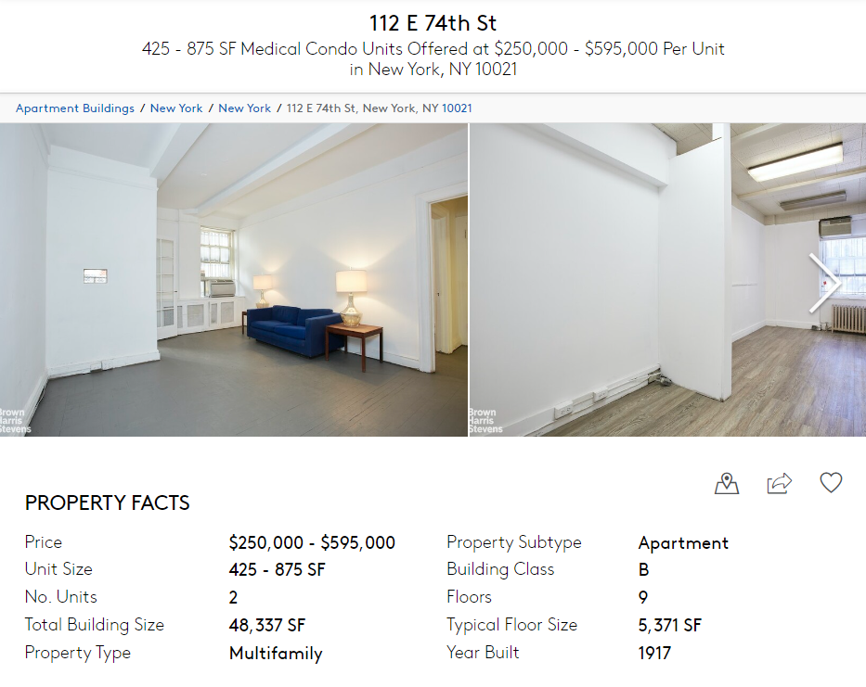

Accessibility

Slide 12
Timeliness

Slide 13
Timeliness
My super model for predicting house prices
2024

Slide 14
Timeliness
2012
My super model for predicting house prices
My data 🙁
2024

Slide 15

Authorization

Slide 16
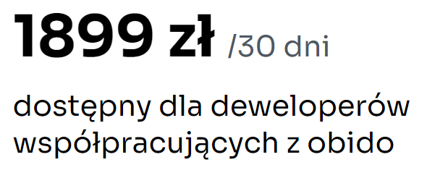
Authorization

Slide 17

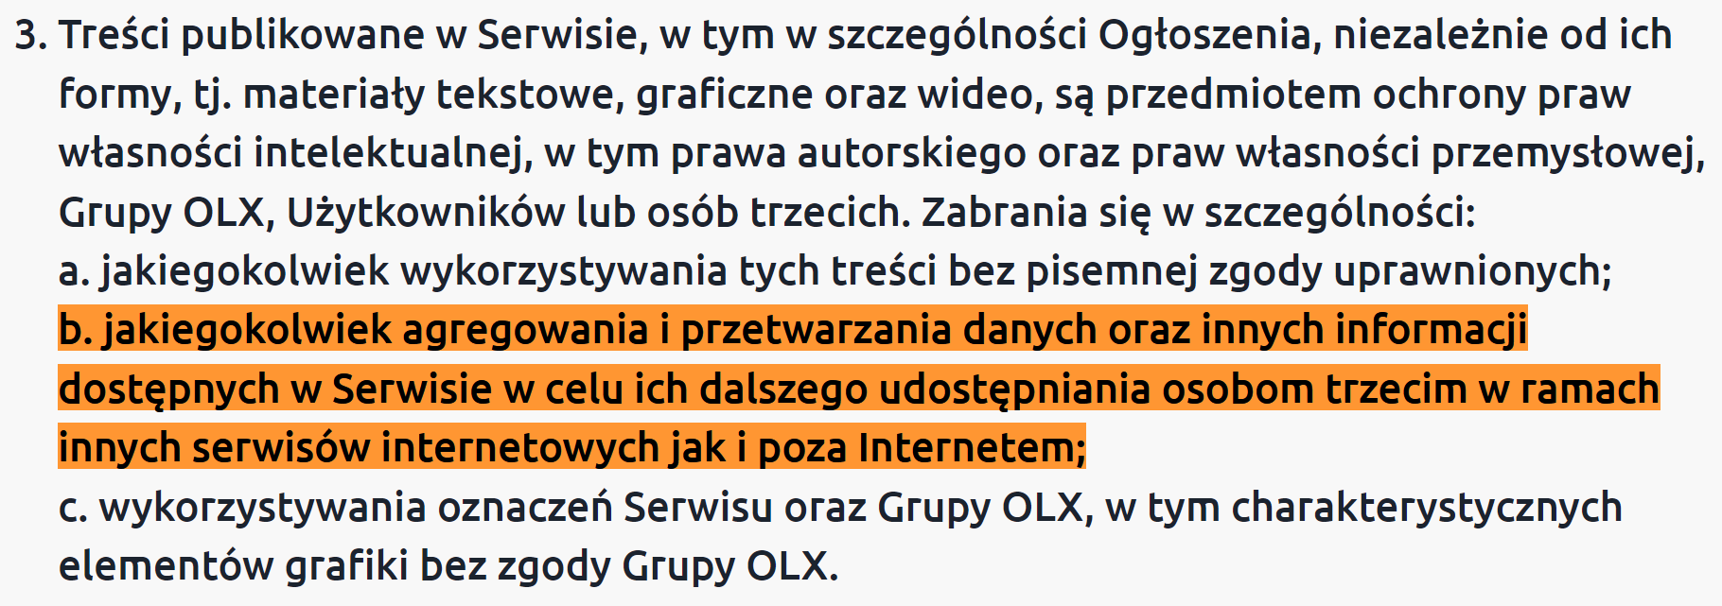
Authorization

Slide 18
Usability

Slide 19
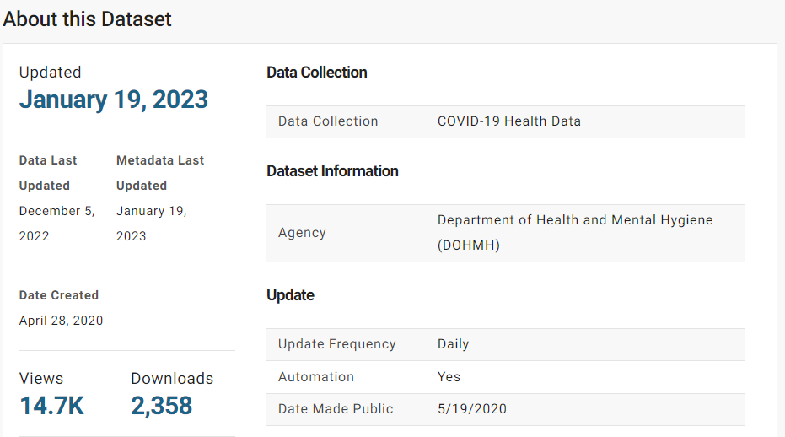
Definition/ Documentation

Slide 20
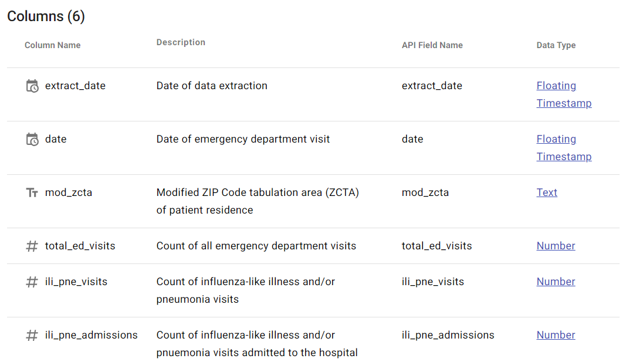
Definition/ Documentation

Slide 21

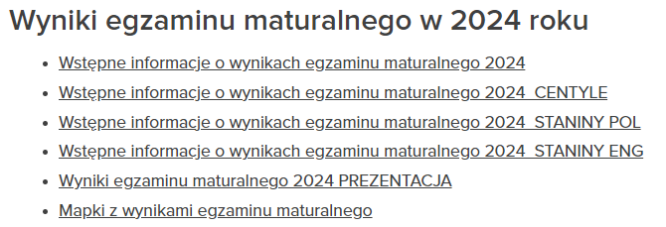
Credibility

Slide 22
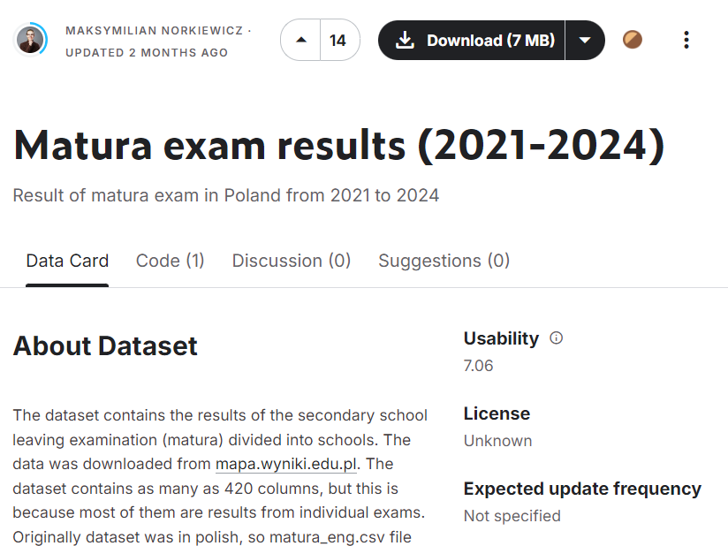
Credibility

Slide 23
Credibility
👍
👎

Slide 24
Reliability

Slide 25
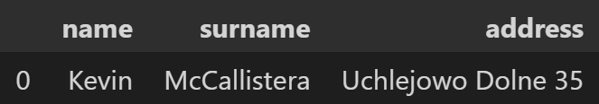
Accuracy

Slide 26

Accuracy

Slide 27
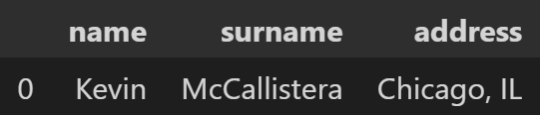
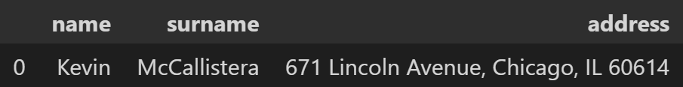
Accuracy

Slide 28




Accuracy

Slide 29
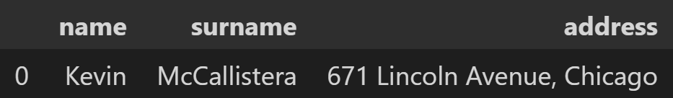
Consistency
1

Slide 30
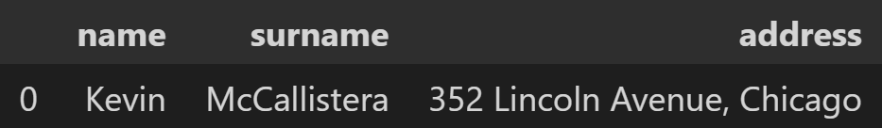
Consistency
1
2

Slide 31
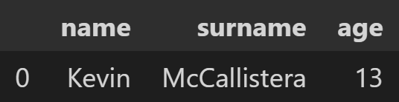
Consistency

Slide 32
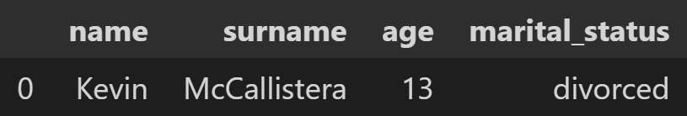
Consistency

Slide 33
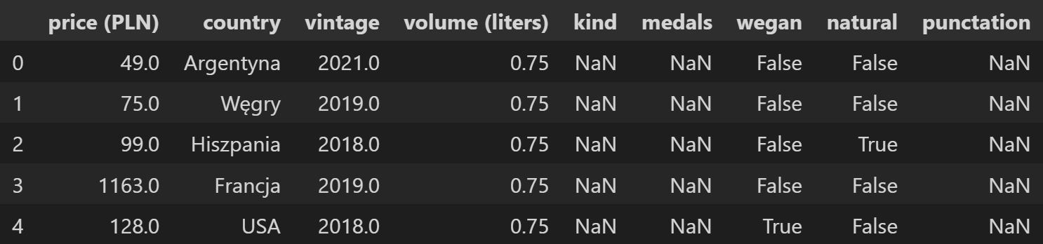
Completeness

Slide 34
Presentation Quality

Slide 35
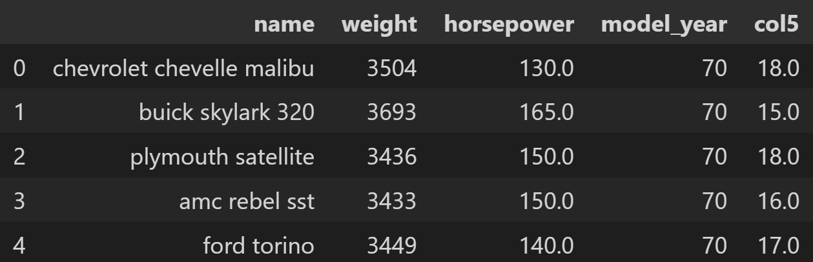
Readability

Slide 36
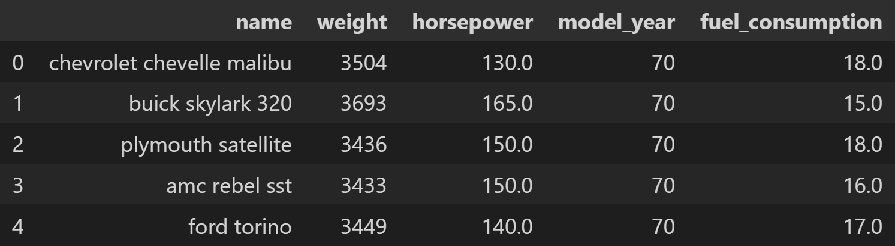
Readability

Slide 37
Readability
l/100km (liters per 100km)
MPG (miles per gallon)

Slide 38

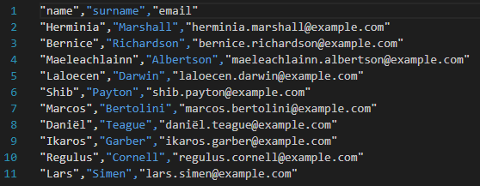
Structure
.csv, .tsv

Slide 39
Structure
SQL

Slide 40
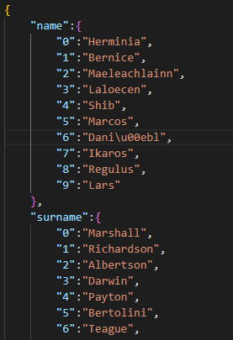
Structure
.json

Slide 41
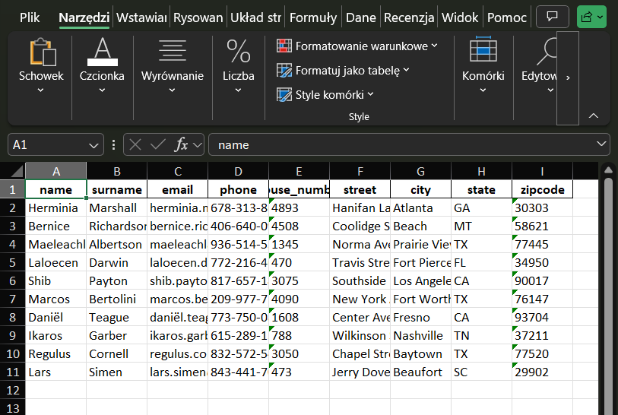
Structure
Excel

Slide 42
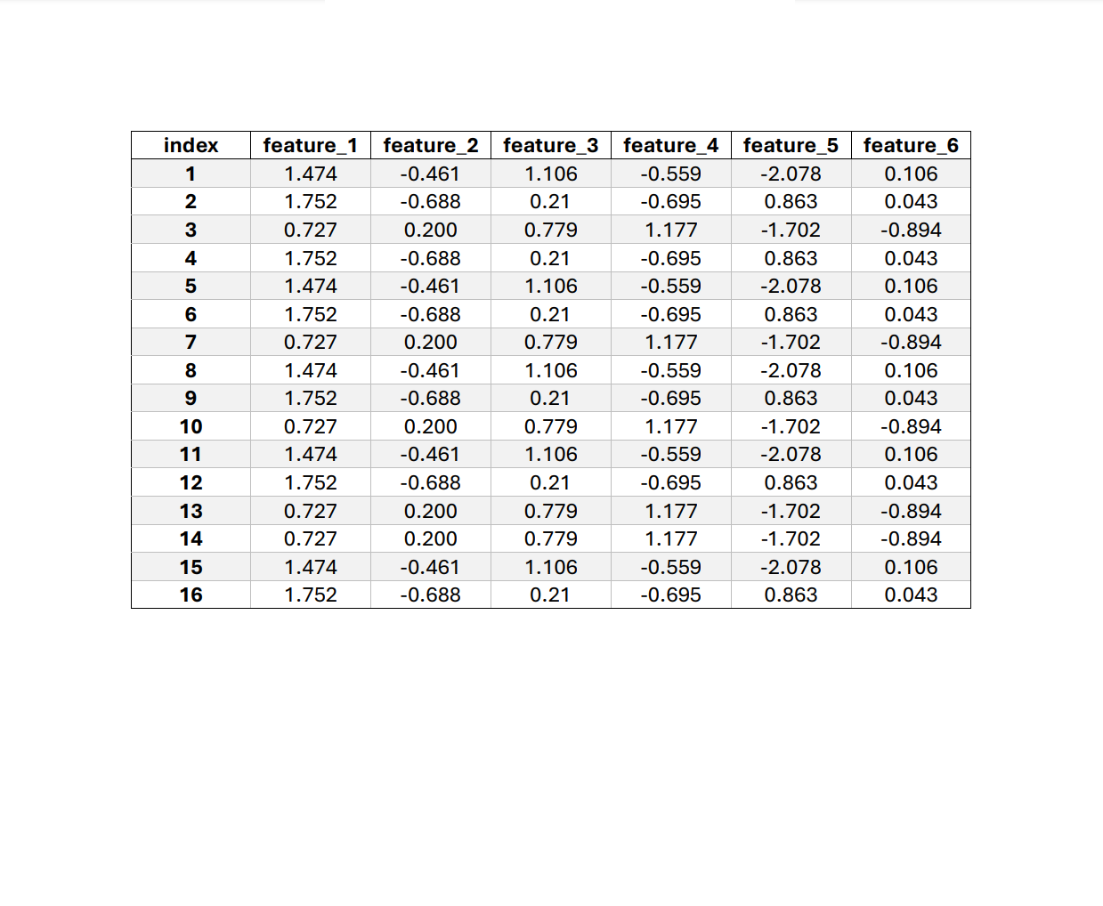

Structure
.pdf

Slide 43
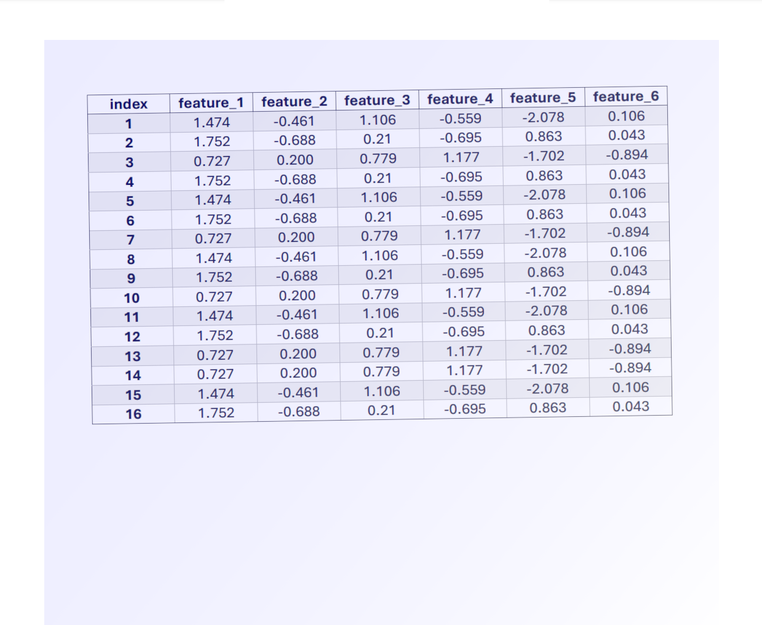

Structure
.pdf

Slide 44
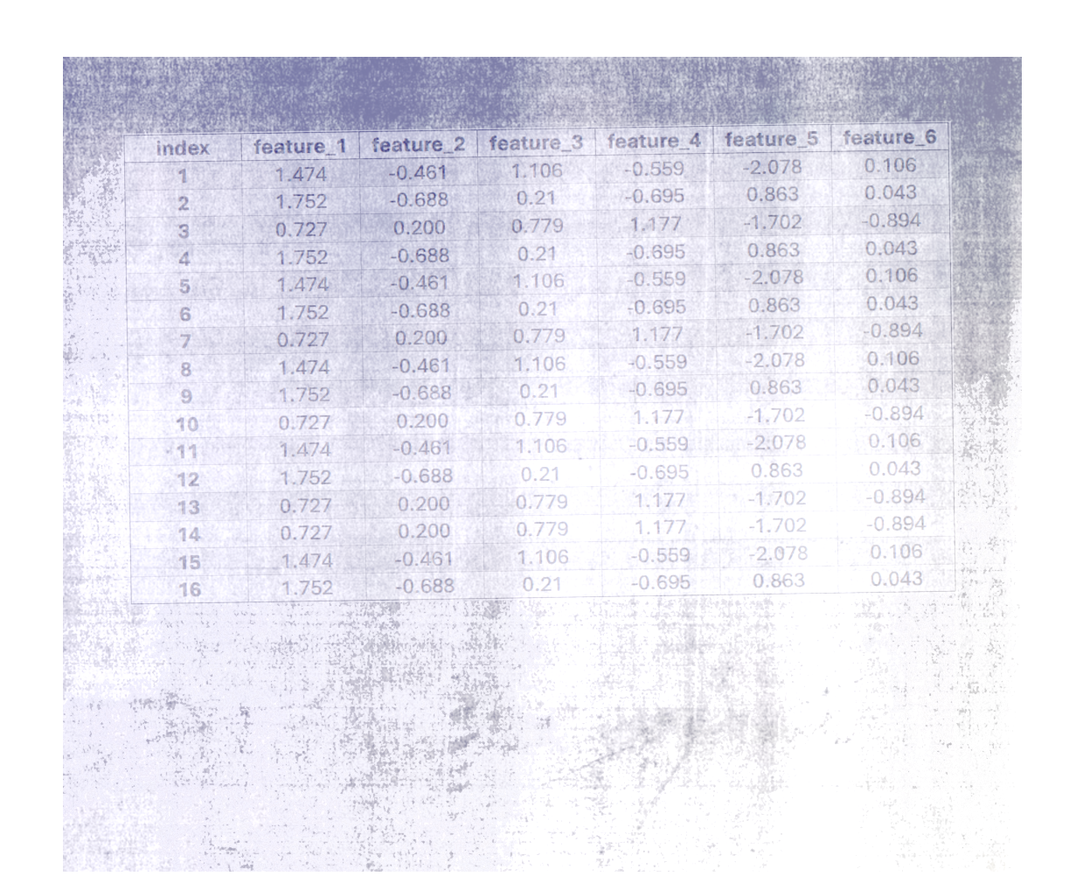

Structure
.pdf

Slide 45
Data cleaning

Slide 46
Why data cleaning is important

Slide 47

GIGO

Slide 49



From unstructured data to structured data

Slide 50
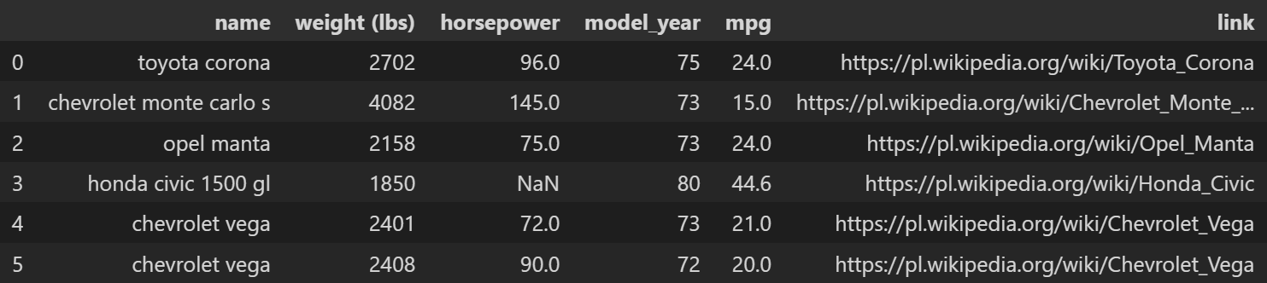
Removing irrelevant data

Slide 51
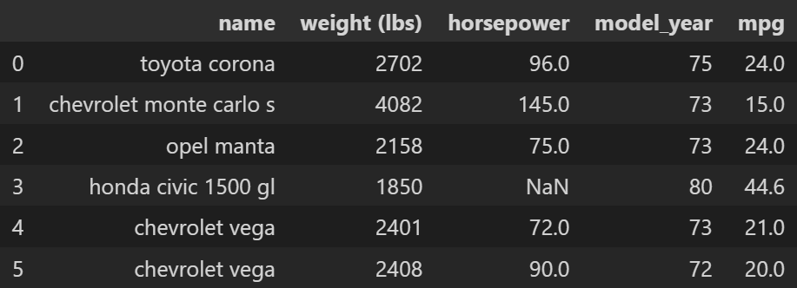
Removing irrelevant data

Slide 52
Removing duplicates

Slide 53
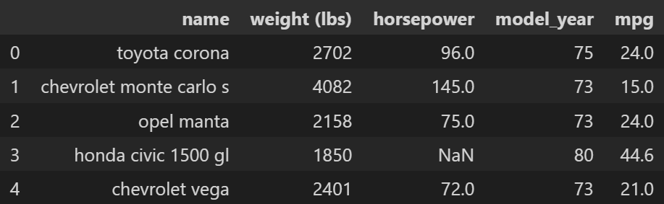
Removing duplicates

Slide 54
Removing duplicates

Slide 55
Type conversions
numpy.int64

Slide 56
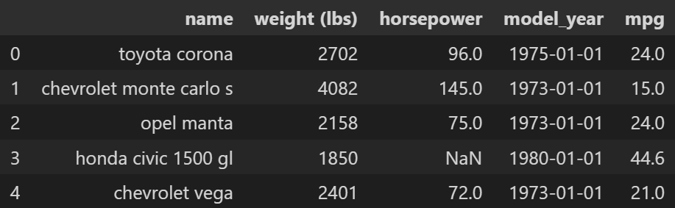
Type conversions
pandas._libs.tslibs.timestamps.Timestamp

Slide 57
Units conversion

Slide 58
Units conversion
pounds
mile per gallon

Slide 59
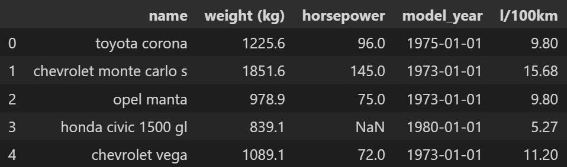
Units conversion
kilograms
liters per 100 km

Slide 60
Dealing with missing values

Slide 61
Dealing with missing values

Slide 62
Dealing with missing values
Delete

Slide 63
Dealing with missing values
Delete or Impute

Slide 64
Deleting rows

Slide 65
Deleting columns

Slide 66
Imputing value

Slide 67
Mean

Slide 68
Mean

Slide 69
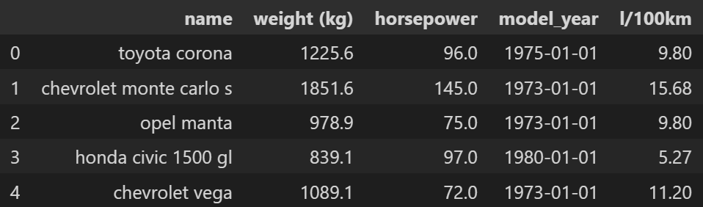
Mean

Slide 70
Median

Slide 71

Median

Slide 72
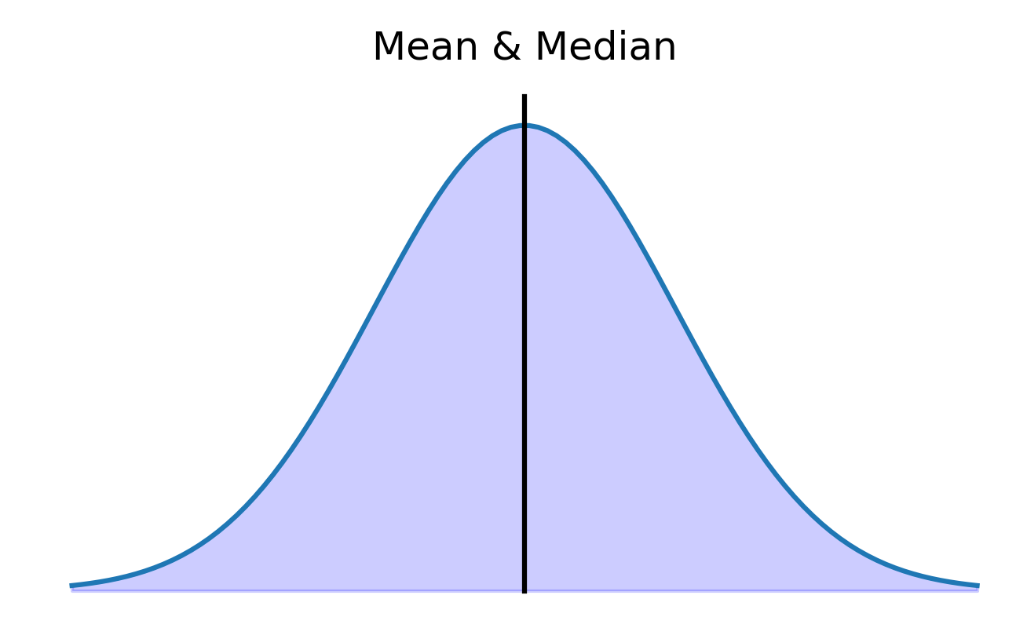
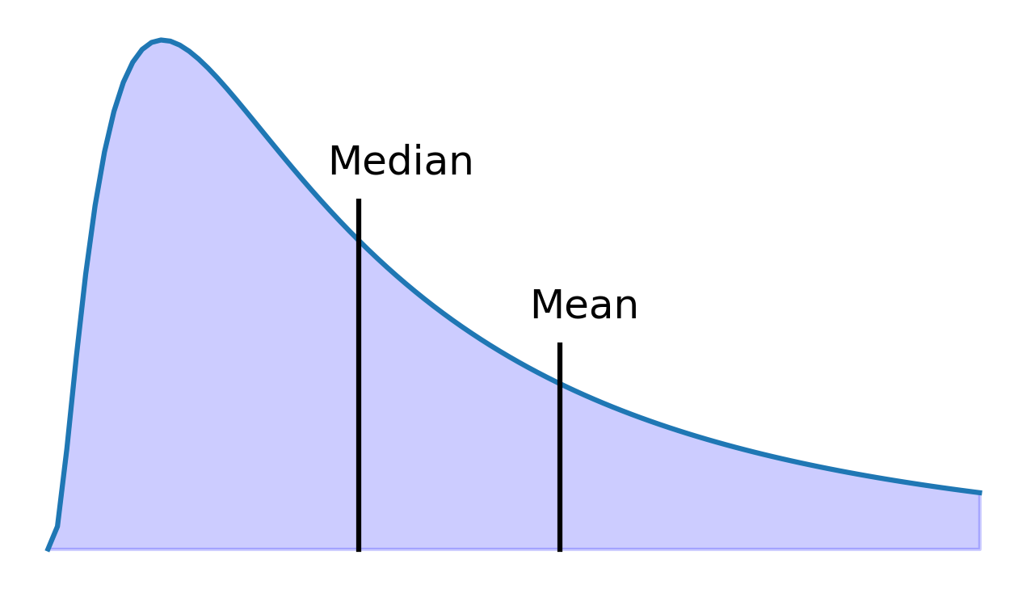
Mean vs. Median

Slide 73
Generate random numbers
μ = 97

Slide 74
Generate random numbers
μ = 97
σ = 34

Slide 75
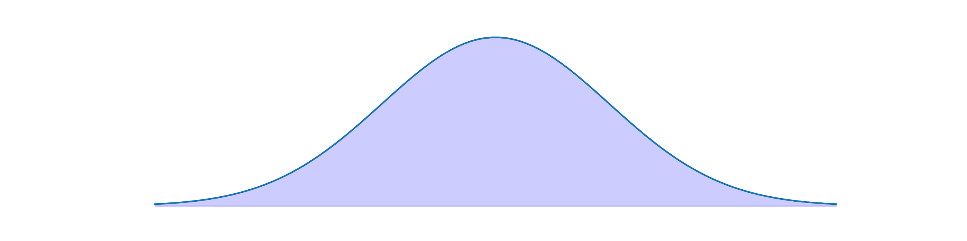
Generate random numbers
μ = 97
σ = 34

Slide 76
Generate random numbers
μ = 97
σ = 34
1.1

Slide 77
Linear regression

Slide 78
Linear regression
training features

Slide 79
Linear regression
training features
training targets

Slide 80
Linear regression
training features
training targets
features for prediction

Slide 81
Linear regression
training features
training targets
features for prediction
missing values

Slide 82
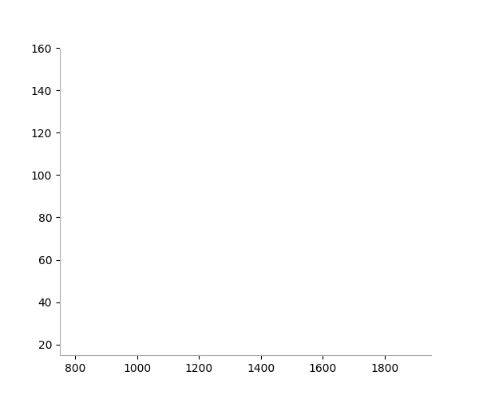
Linear regression

Slide 83
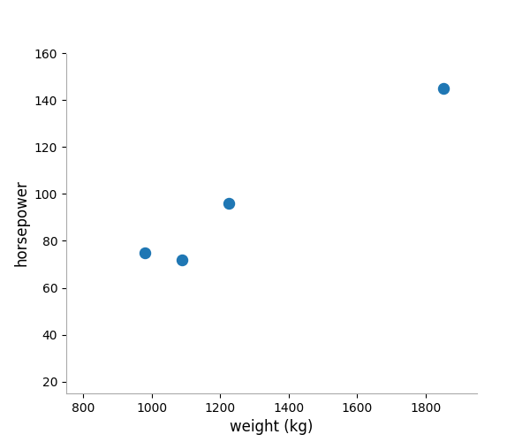
Linear regression

Slide 84
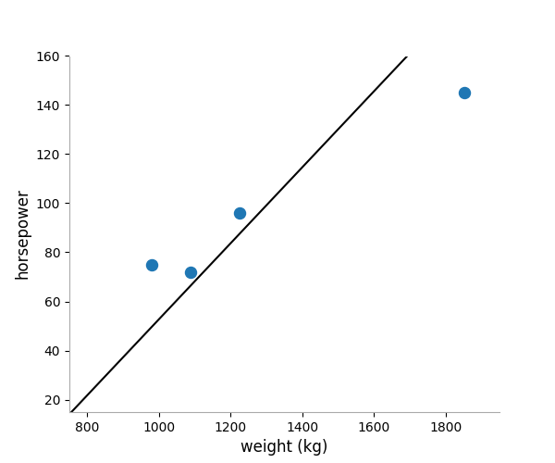
Linear regression

Slide 85
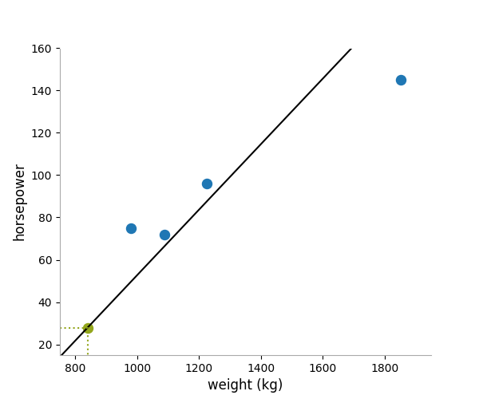
Linear regression

Slide 86

Linear regression

Slide 87
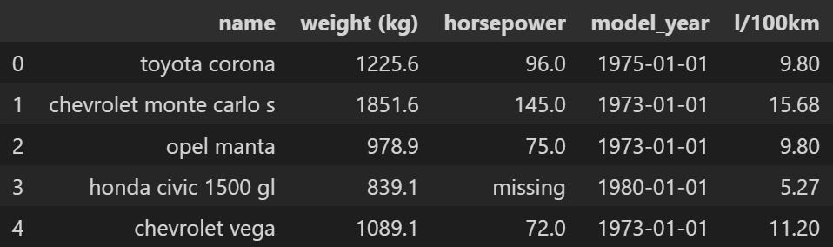
Flags

Slide 88
References
https://towardsdatascience.com/the-ultimate-guide-to-data-cleaning-3969843991d4
https://towardsdatascience.com/an-extensive-guide-to-exploratory-data-analysis-ddd99a03199e
https://account.datascience.codata.org/index.php/up-j-dsj/article/view/dsj-2015-002
https://www.sbctc.edu/resources/documents/colleges-staff/commissions-councils/dgc/data-quality-deminsions.pdf
https://data.cityofnewyork.us/Health/Emergency-Department-Visits-and-Admissions-for-Inf/2nwg-uqyg/about_data

